Slide 1
Demographic Aspect

Slide 2
Since 1965, world population has more than doubled. Neo-Malthusians or “Population Bombers” (e.g., Paul Ehrlich, Lester Brown, Garret Hardin, and David Pimentel) have long argued that we are in danger of exceeding Earth’s carrying capacity.
Over the past few years, we have experienced the slowest growth since the 1940s. Cornucopians or “Population Optimists” (e.g., Julian Simon) believe that population is not that big a problem and that economic growth and technology will see us through.
Still others claim that our focus on human population growth is misplaced. They view excessive growth as a symptom of other bigger problems. People in this camp are “Gender Equity” or “Equity” Advocates.

Slide 3
If one were to analyze a series of world population density maps published over the past several decades, two important points emerge:
1) Population is not distributed uniformly around the world.
  Some areas support large populations (One out of every three people in the world is from either India or China); other areas are very sparsely populated.
  2) Population patterns and rates of growth change over time.
  With respect to growth rates, there are tremendous disparities around the world. We live in “two very different demographic worlds,” one relatively small, old, and wealthy (with very high consumption rates per capita) and the other very large, young, and poor (with relatively low consumption rates per capita).

Slide 4
Population Distribution
MDCs account for 20% of world population but consume the lion’s share of resources. Some countries (e.g., Denmark, Sweden) have reached ZPG (births plus immigration = deaths plus emigration); others have negative growth rates (e.g., Italy, Germany, Hungary, Japan).
LDCs account for 80% of world population. Some countries (esp. in the Middle East and Africa south of the Sahara) have very high growth rates. Nigeria - the most populous country in Africa - had 33 million inhabitants in 1950. By 2050, it is projected to have 300 million.
By 2025, MDCs will account for only 16% of world population. This is because over 90% of population growth over the next 30 years will occur in LDCs (esp. “hot spots” Africa and Middle East)

Slide 5
Population Theorists
Food production tends to grow arithmetically.
  1, 2, 3, 4, 5, …
Populations tend to grow geometrically.
  1, 2, 4, 8, 16, …
This will obviously lead to significant problems for the population over time. But how to deal with these problems?

Slide 6
Historically, what has caused world population to grow?
When we look at world population growth
over the past several thousand years, we
see that it has not grown evenly. There
have been spurts in growth.

Slide 7
Spurts in population growth (Three Revolutions)
ca. 8000 B.C. - Agricultural Revolution (plant and animal domestication)
ca. 1750 A.D. - Industrial Revolution (agricultural mechanization, transport, sanitation, health)
ca. 1950 A.D. - Medical Revolution (elimination of many historical causes of death)

Slide 8
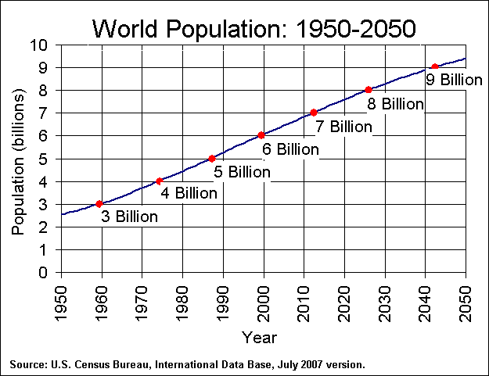
And it keeps on growing . . .
It took all of human
history to reach 1 billion
people in 1804.
It only took 150 years to
reach 3 billion by 1960.
World population has more
than doubled since 1965.

Slide 9
How do we measure population changes?
Rate of Natural Increase - Percentage by which a population grows in a year (birth rate minus death rate). Does not take migration into account. Current rate is about 1.14% for the world.
Doubling time - Number of years needed to double a population. Current doubling time is about 61 years for the world (in the 1960s it was 35 years).
Recent evidence suggests . . .
  that population growth is slowing down
  that doubling time is increasing

Slide 10
Population Doubling Time
    How long will it take for a population of a given area to double in size?
    • Doubling time assumes the population will grow at a given annual rate.
    • Approximated by dividing the annual rate of population into 70.
    World = 50
    U.S.A = 35
    MDC = 550
    LDC = 40
    Example: Bangladesh
    70/R.N.I. = 70/1.292 = 54.18 years

Slide 11
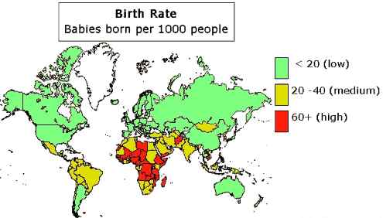
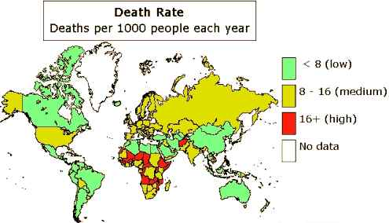
Demographers also look at . . .
crude birth rate - total number of live births in a year per 1000.
  CBR = (b/p)*1000
crude death rate - total number of deaths in a year per 1000
  CDR = (d/p)*1000

Slide 12
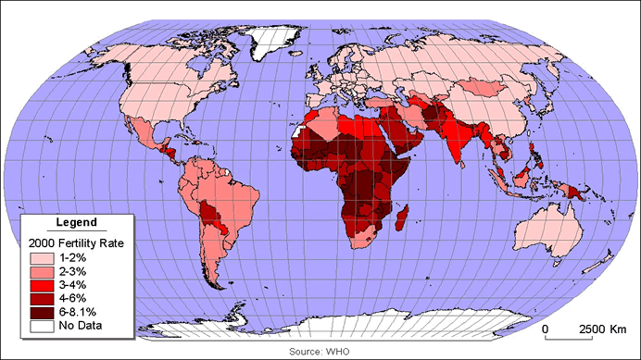
Demographers also look at . . .
Total fertility rate - number of children a woman will have during child-bearing years (ages 15-49)
This rate varies from just over 1 (Japan, Italy) to around 7 (Niger, Mali).
U.K. | Total fertility rate
1975-1980 | 1.72
1980-1985 | 1.80
1985-1990 | 1.81
1990-1995 | 1.78
1995-2000 | 1.70
2000-2005 | 1.66
Africa | Fertility Rate
1975-1980 | 6.60
1980-1985 | 6.45
1985-1990 | 6.11
1990-1995 | 5.67
1995-2000 | 5.26
2000-2005 | 4.97

Slide 13
Fertility Rates (Cont’d)
Average fertility rate for the world is 2.61; 2.05 in the U.S. (CIA 2009)
Fertility rate across the globe has been on the decline over the past 50 years - except in Africa. In Mexico, the average family in 1975 had 7 children. In 2000, the average was down to 2.5.
China introduced a policy known as “later, longer, fewer” in 1971 followed by a 1 child per family policy since 1979 which has reduced the fertility rate. The rate has dropped from 6.2 in 1949 to 1.6 in 2006. (China’s population grew by 700 million between 1950 and 2000).

Slide 14
Demographers also look at . . .
infant mortality rate - number of infant deaths (<1 year) per 1000 live births
  95 percent of the estimated 529,000 maternal deaths in 2000 occurred in Africa and Asia.
life expectancy - number of years a newborn infant can be expected to live
  Even in the U.S. there are pockets where infant mortality is high and life expectancy is low for some members of society (e.g., Native American Indians).

Slide 15
Factors Affecting Birth/
Fertility Rates
Urbanization
Infant mortality rate
Availability of pension systems
Availability of legal abortions
Availability of reliable birth control methods
Religious beliefs, traditions, and cultural norms
Importance of children as part of the labor force
Average age at marriage

Slide 16
Why is population increasing at different rates in different countries?
To answer this, we’ll take a look at population pyramids and then talk about demographic transition;
Nearly all the population growth is occurring in poorer countries - those countries least able to support the growth.

Slide 17
Population Pyramids
An analytical tool, a bar graph, that allows to examine the distribution of a country’s population by age and gender.
Tells us something about dependency (young and old).
Tells us something about the future as well (demographic momentum).
The shape of a pyramid is determined by the crude birth rate.

Slide 18
Population Pyramids
Shape of the pyramid varies for different countries according to age distribution of the population. The shape of the pyramid explains the followings:
1. Sex ratio: Percentage of males and percentage of females.
2. Age structure: Percentage of each stratum.
3. Mortality and emigration: Slope of the sides.
4. Life span: Height of the pyramid and shape of the apex.
6. Dependency Ratio:
Total dependency ratio: < 15 years + > 60 years x 100/15-60 years in the same locality.

Slide 19
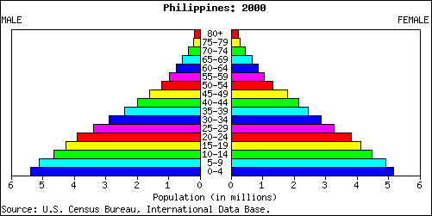

Slide 20
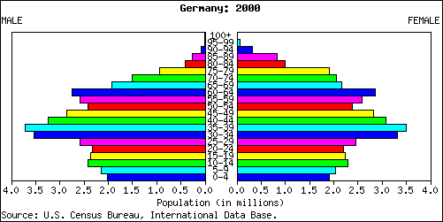

Slide 21
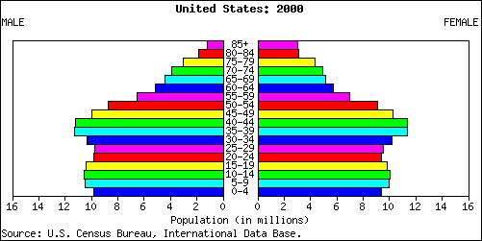

Slide 22
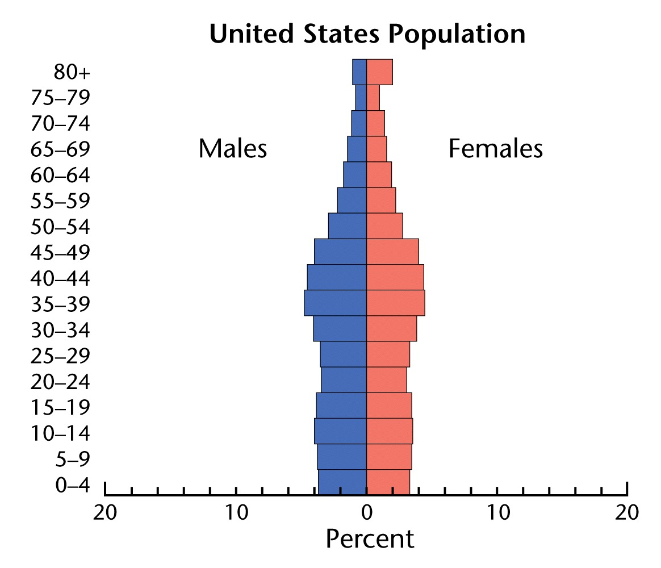
U.S. (slow growth)

Slide 23
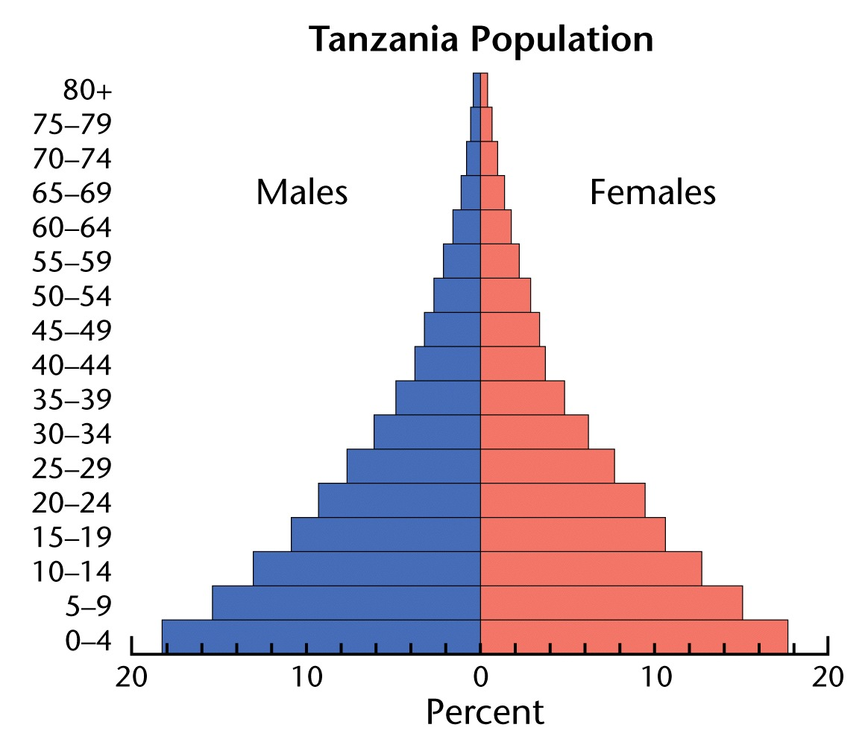
Tanzania, Africa (rapid growth)

Slide 24
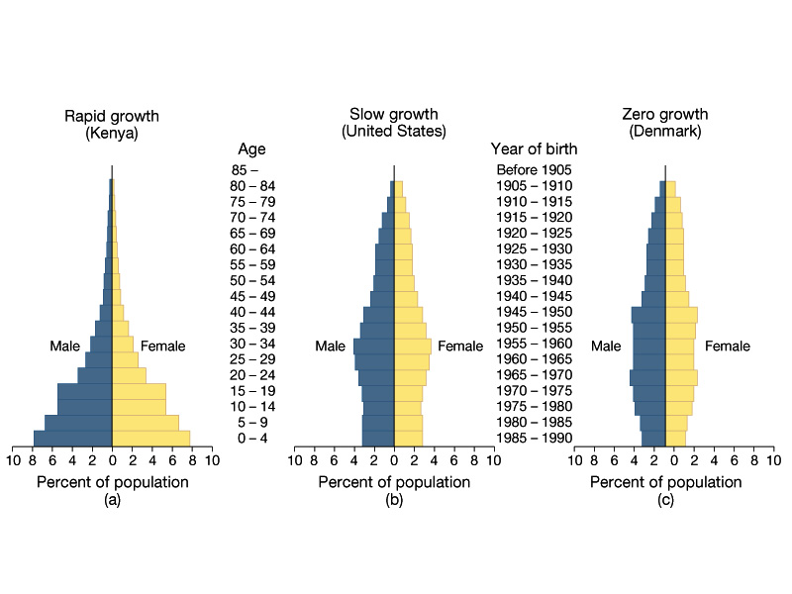
Denmark (zero growth)

Slide 25
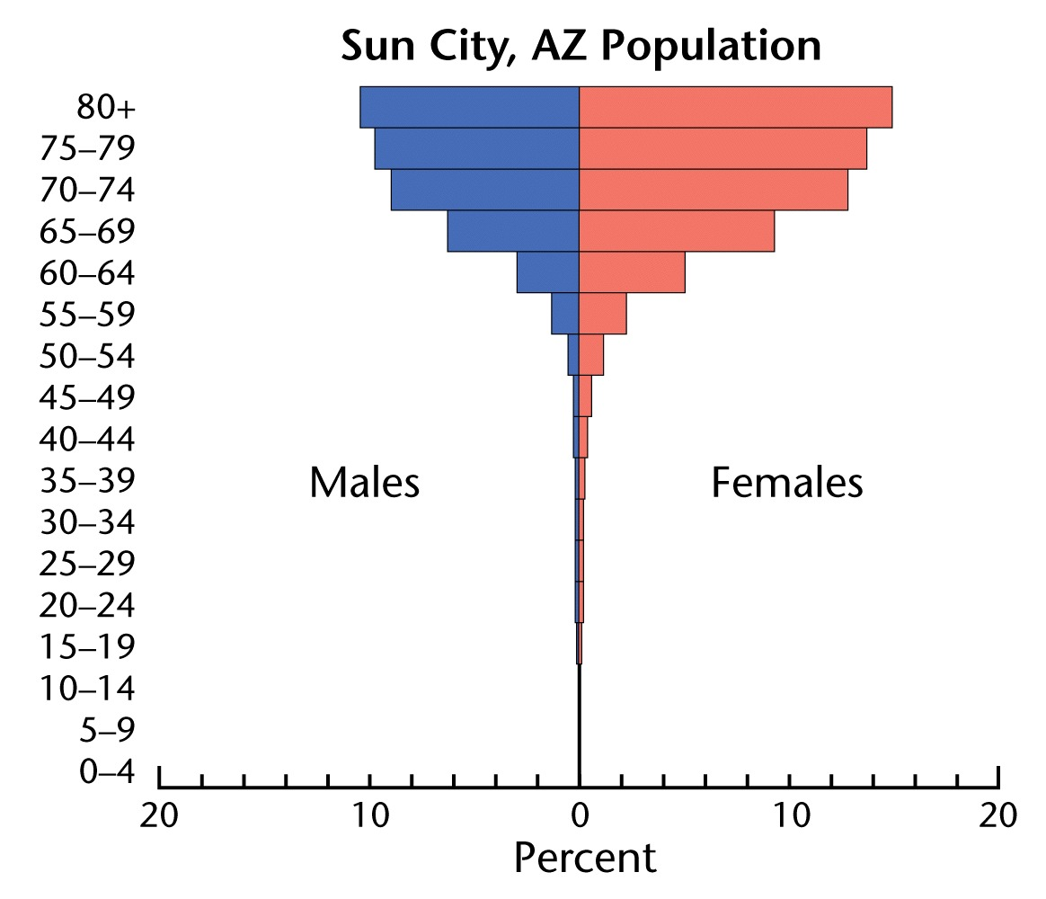
Sun City (Arizona) retirement community

Slide 26
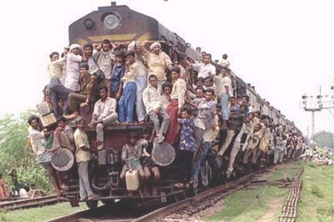
Overpopulation

Slide 27
Overpopulation….
The world’s population increases by 2.5 people per second.
By 2050, the world’s population will be 9.1 billion and China & India will account for half of that.
At current growth rates, the world’s population in 2150 will be 244 billion… and in 2300 will be 134 trillion.

Slide 28
Overpopulation…
What are the contributing factors to overpopulation?
  Cost of and accessibility of birth control methods;
  Cultural barriers (religion; little choice for women; men wanting many children; preference of having boys; religious beliefs);
  High death rates, so overcompensation with the number of births;
  Government incentives.

Slide 29
Overpopulation….
What are some consequences of overpopulation?
  Famine
  Urbanization
  Shortage of jobs
  Poverty
  Shortage of space
  Shortage of natural resources
  Pollution
  Conflict / war
  Lack of provision of government services

Slide 30
Overpopulation….
What are some solutions to overpopulation?
  Technology and innovation
  Improved education of women
  Improved access to birth control
  Laws limiting number of children people can have

Slide 31
Overpopulation…..
In both the developing and the developed world, the number one solution to overpopulation is the education of women:
  Women not in the labour force have fertility rates more than twice than that of women in the labour force;
  High income women have half as many children as low income women;
  A woman with a college degree will have half as many children as a woman who did not graduate from high school.

Slide 32
Policies to lower birth rate
Forced
  One-child policy (China)
Voluntary
  Availability of birth control
  Incentives for small families
Social
  Empowerment of women
  Better health care and education
  End to child labor
  Social security

Slide 33
Overpopulation….
Today the debate is carried on by . . .
Neo-Malthusians (a group named for English economist Thomas Malthus)
Gender-Equity and Equity advocates (who trace their roots to the writings of Karl Marx), and
Cornucopians (best represented by the work of the late economist and statistician Julian Simon)

Slide 34
Overpopulation…
Thomas Malthus (1766 - 1834) was an English essayist and minister whose 1798 treatise on population got the ball rolling. It contained three key points:
food supply grows arithmetically while population grows geometrically
passion between the sexes is “constant and necessary”
resources are limited

Slide 35
Thomas Malthus (1766 - 1834)
His conclusion? Collapse in the future. His predictions have not come true – he did not foresee technological advances, especially where agricultural output is concerned.
Must understand what was happening in London at the time he was writing.

Slide 36
Karl Marx
Karl Marx vehemently opposed Malthus’s positions, arguing that population growth is a symptom rather than a root cause of poverty, resource depletion, racism, classism, and other problems.
Today, people like Betsy Hartmann and Paul Harrison have picked up on this “equity” argument. They state that most environmental problems have been caused by over consumption in the “first world” countries and poverty in the “third world” countries.
We need to raise standards of living, address the low status of women, expand services, education, reproductive rights.

Slide 37
Cornucopians
Then there are the Cornucopians. According to Julian Simon, population may or may not be the cause of environmental problems. He maintains that the quality of life by a variety of measures is improving in many places around the world.
To Simon, population growth is a good thing - people are the “ultimate resource” and the more people on earth, the more minds we will have working on our problems.
The solution lies in economic policies that promote economic growth.

Slide 38
Who is right?
Each camp makes some good points.
Without a doubt, explosive and unchecked population growth will have negative effects on the earth.
Without a doubt, resources and amenities are not distributed equitably around the globe and poverty is at the root of many of the world’s problems.
Family planning and education have done much to reduce fertility rates around the world. We are better off now in terms of reducing growth than we were 30 years ago.

Slide 39
Demographic Transition Model

Slide 40
Demographic Transition - Process of change in a society’s population
Descriptive
  PHASE ONE: “Pre-Modern Era”: Birth rates and death rates are high. The natural increase gap is small - population grows slowly. No country is really in stage one.
  PHASE TWO: “Industrializing Era”: Death rate declines and birth rate remains high. The natural increase gap becomes larger – population explosion. Many developing countries are currently in stage 2 or 3.

Slide 41
Demographic Transition ……
  PHASE THREE: “Mature Industrial”: Birth rate begins to decline and the death rate remains low. The natural increase gap narrows – population explosion slows.
  Many developing countries are currently in stage 2 or 3.
  PHASE FOUR: “Post-Industrial”: Birth rate and death rate tend to be low and steady. The natural increase gap is small – slow population growth.
  Many developed countries are currently in stage 4.
  PHASE FIVE
  Not part of original model
  Many developed countries are seeing declining rates of natural increase and are focusing on immigration to fill jobs
  A few developed countries are in stage 5.

Slide 42
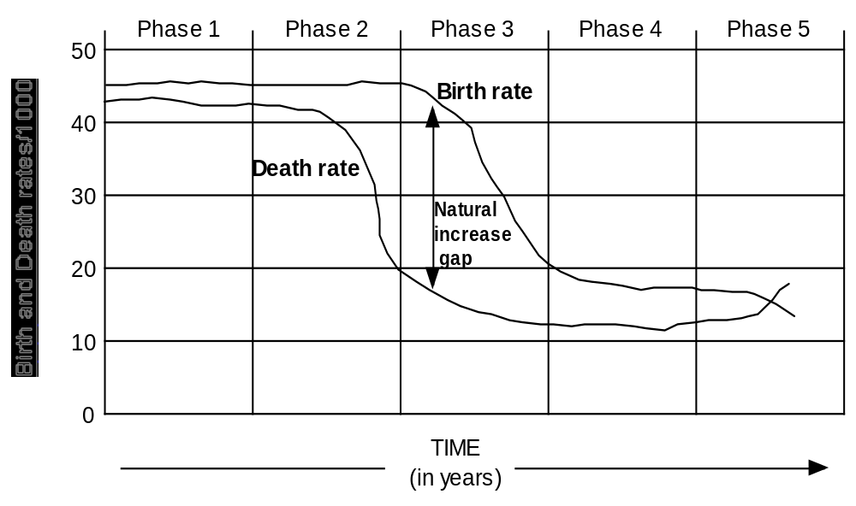
Demographic Transition Model
Demographic Transition Model

Slide 43
Problems with the Demographic Transition Model
Based on European experience, assumes all countries will progress to complete industrialization;
Many countries reducing growth rate dramatically without increase in wealth – TV and family planning seem to be at work;
On the other hand, some countries “stuck” in stage 2 or stage 3, particularly in Sub-Saharan Africa and Middle East.

Slide 44
Demographic Analysis
Migration – the movement of people from one place to another
Immigration – the movement of people into a geographical location
Emigration – the movement of people out of a geographical location
Push and Pull factors:
Push factors are reasons persons leave a location
Pull factors are reasons persons are attracted to a location
Much of migration is internal; people moving about their country without crossing international boundaries.

Slide 45
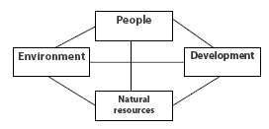
Population and Environment Interrelationship
A very simple interaction between population and environment is that high growth of population may lead to over consumption of natural resources and degradation of ecosystem and environmental potentials.
Notes:
Environment and population are closely related terms. environment can be defined as the sum total of total living an non- living things present in our surroundings and interacting with each other in a harmonious way. Similarly, population can be defined as the total number of adults, infants, children and aged people living in a certain place at a certain time. Environment and population are closely related terms. population/human beings rely on environment for their growth, development and survival. We get all of our basic needs from the environment. Similarly the environment also depends upon us. We are the only intelligent creatures who are capable of preserving, conserving and promoting the environment. In this way, population and environment are inter-related with each other.

Slide 46
It is important to examine the following issues to establish relationship between Environment and Population (Lori Hunter)
The relationship between demographic factors-- population size, distribution, and composition--and environmental change;
The mediating factors that influence this relationship: technological, institutional, policy, and cultural forces;
Two specific aspects of environmental change affected by population dynamics: climate change and land-use change.

Slide 47
Hunter’s conclusion
Hunter concludes that population dynamics have important environmental implications but that the sheer size of population represents only one important variable in this complex relationship.
Other demographic dynamics, including changes in population flows and densities, can also pose challenging environmental problems.

Slide 48
Population Pressure on Land and Development…..
The country has reached a point of maximum utilization in terms of potential arable land and intensity of cropping and the only option left is to improve the agricultural production through modernization of agriculture;
    a. Wheat Production:
    Pakistan = 2.1 metric tons per hectare
    Germany = 6.9 metric tons per hectare
b. Corn Production:
India = 1.6 metric tons per hectare
U.S. = 7.1 metric tons per hectare
But it is also true that without improving the human capital such a technological transformation may not be feasible.

Slide 49
Group Discussion Topic
Identify two major environment and development related problems of Bangladesh and develop appropriate strategies to address those problems in a sustainable way.

